Slide 1
Khan Academy Analysis
Roshan Komaravolu

Slide 2
Objectives & Process
Identify trends in the active student data and the hours spent on Khan Academy per active student:
  What are the participation trends like?
    Active students per school tracked across months.
    Active students per school compared within districts.
    Active students compared to registered students.
  How effective is the program? How many schools are hitting the recommended 30 mins/week?
    Actual hours per student per month (within each school) compared to Ideal hours (30 mins * Registered Students * 4 weeks)
    Actual hours per student compared across districts.
Trends can be identified by
  comparing Active Students and Learning hours versus time
  comparing Active Students and Learning hours versus geography (comparison between districts).
The best performing districts & schools need to be identified and emulated based on deeper metrics not present in data (be it access to infrastructure, teaching methodology, segregation of students into study groups, etc.)

Slide 3
Assumptions and facts.
Facts -
  Active students per month aren’t unique.
    ∑(Active Students) ≠ Registered Students.
  Recommended student learning time on KA = 30 minutes per week.
  Data contains 15 ZPPs per district.
Assumptions -
  The data is sourced from areas classified as “Rural” and ZPP stands for Zilla Parishad.
  Ideal Time spent on KA for a school = 30 * Registered Students * 4
  Every active student isn’t necessarily spending the recommended 30 mins.
  The KA integration is not on mandatory/testing components of curriculum.
  Infrastructure to access Khan Academy is not a hurdle (thereby not limiting access to KA).

Slide 4
Analysis
Metrics provided -
Active Students.
Hours of learning on Khan Academy Per Student.
Trends on users can be found by plotting metrics versus varying time (months) and varying area (districts).
Assuming an “Active Student” doesn’t spend 30 mins, we need to plot (per month) -
Ideal total time as 30 mins per student * registered students.
Real total time as Hours of Learning on Khan Academy Per Student * Active Students.

Slide 5
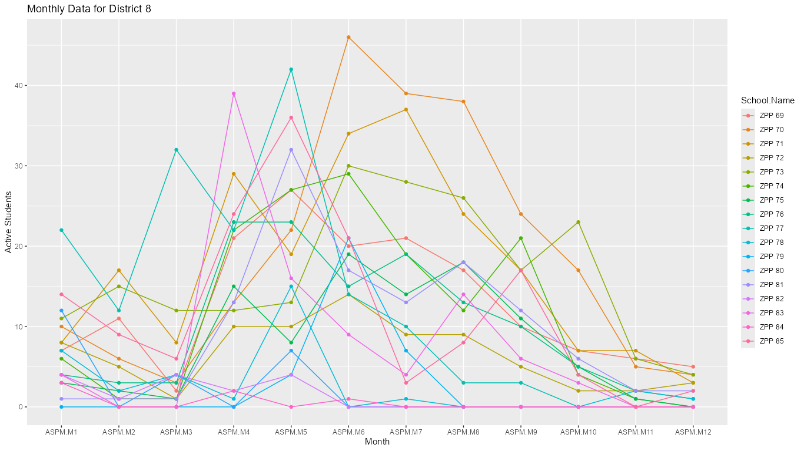
Active User trends.
Active students follows a trend where the participation goes up in middle of the year and trails off at the end of the year.
There are schools where the participation was high at the end of year but non-existent anytime else.
District 13 has the highest active users as a percent of total registrations on an average.

Slide 6
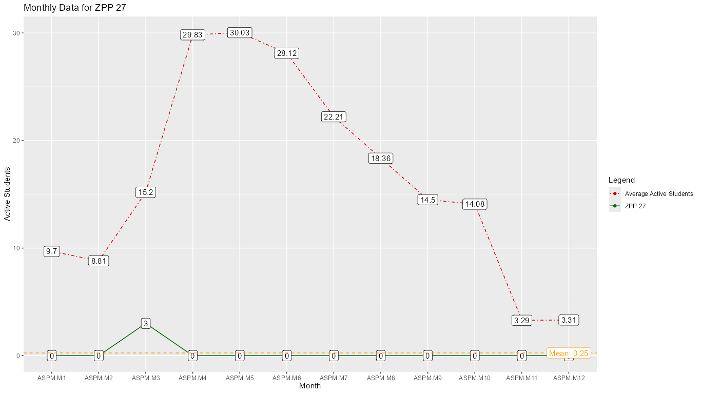
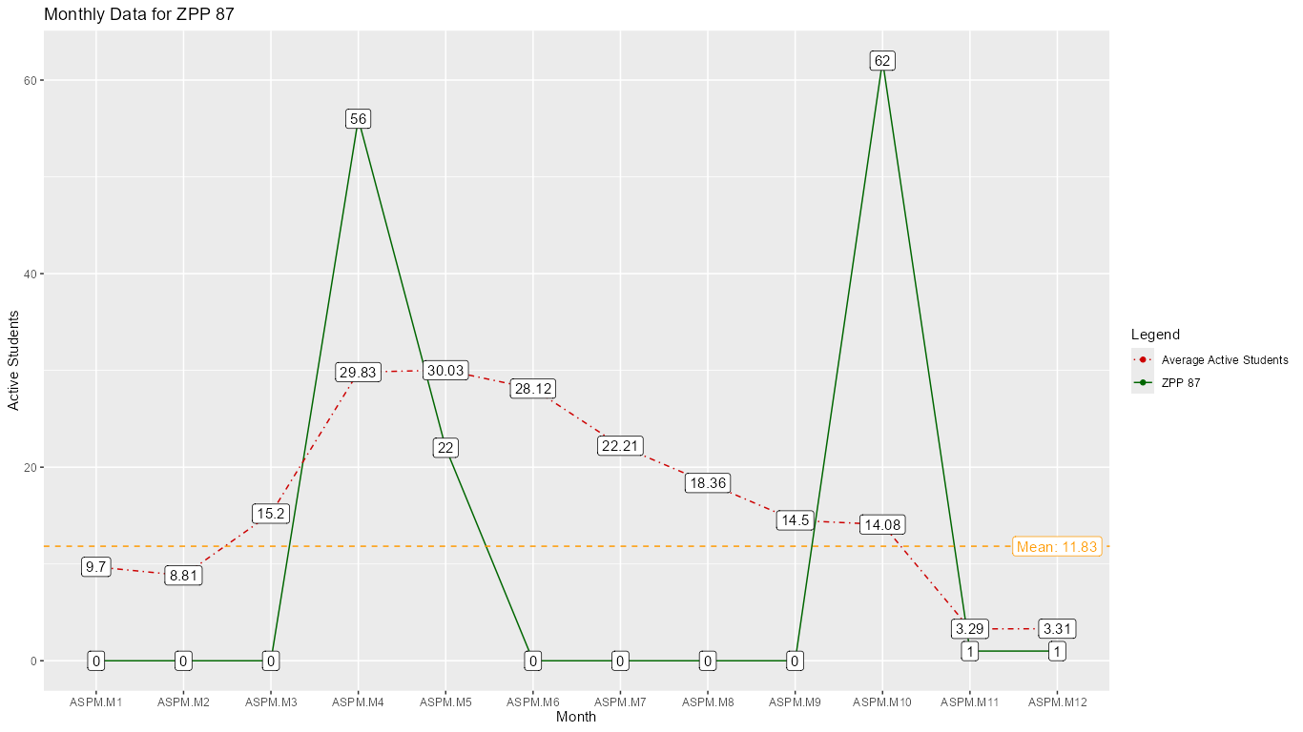
Interesting Schools.
Some of the schools can be considered outliers in the sense that they saw no active participation or had 1-2 spikes in student participations.

Slide 7
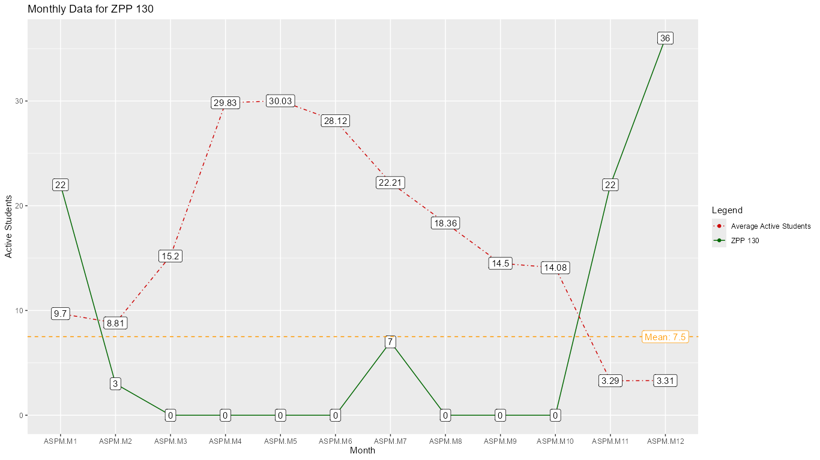
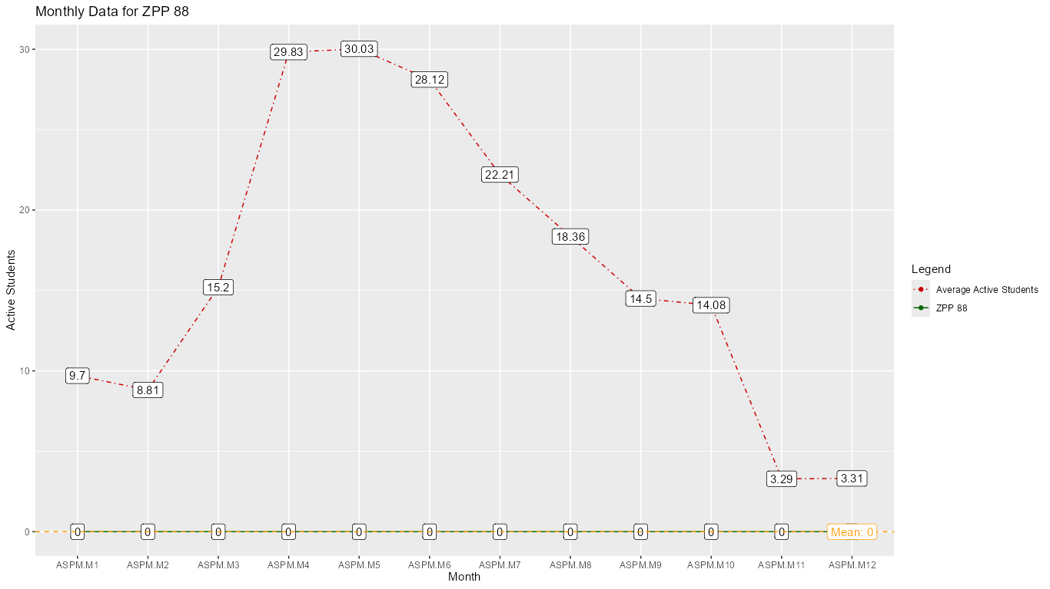
There was another school that stood out the most - ZPP 145.
The rest of the graphs can be found on the github repository along with the code used to create the visualisation and analysis.

Slide 8
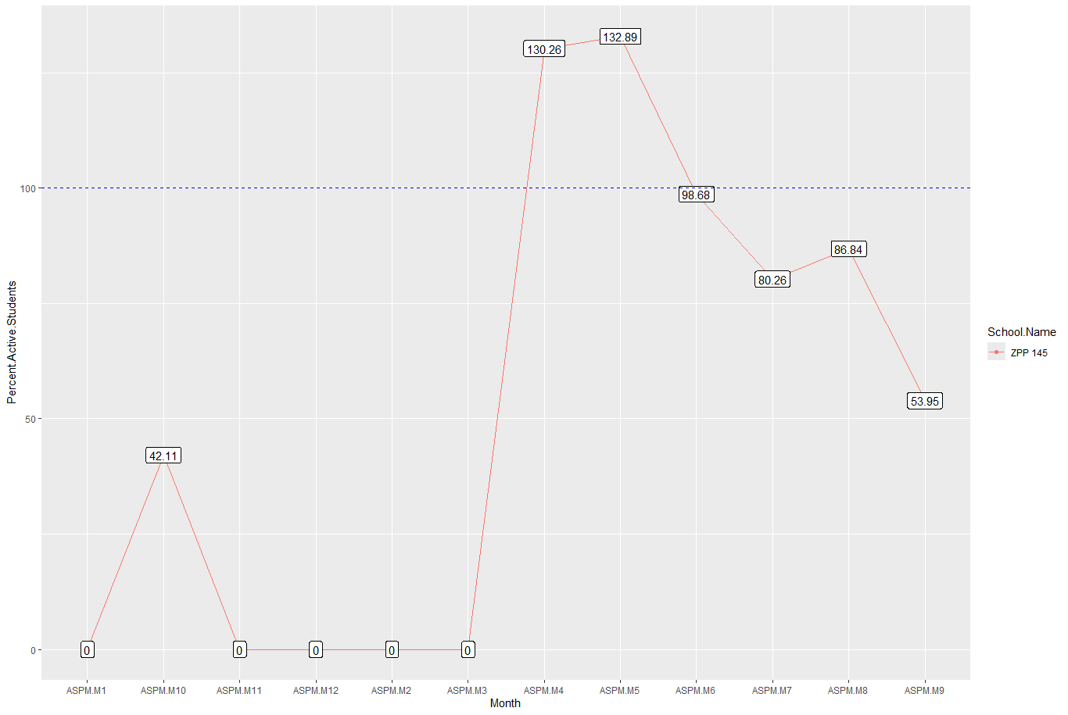
The case of ZPP 145
The plot is for Percentage of active students of Total registered students.
Clearly the data is wrong or there was an event which enabled more one time users. The trend of High percentage of users after the Spike warrants further investigation.

Slide 9
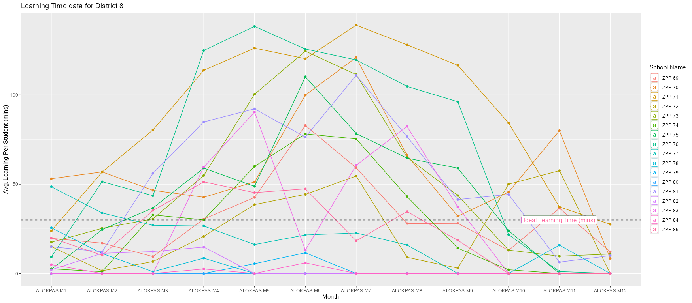
Time spent on Khan Academy
The learning time spent on KA per student follows a similar trend to that of active students, i.e., increases in the middle of the year and trails off at the end.
There are schools however which have consistently beaten the Ideal learning time of 30 mins.

Slide 10
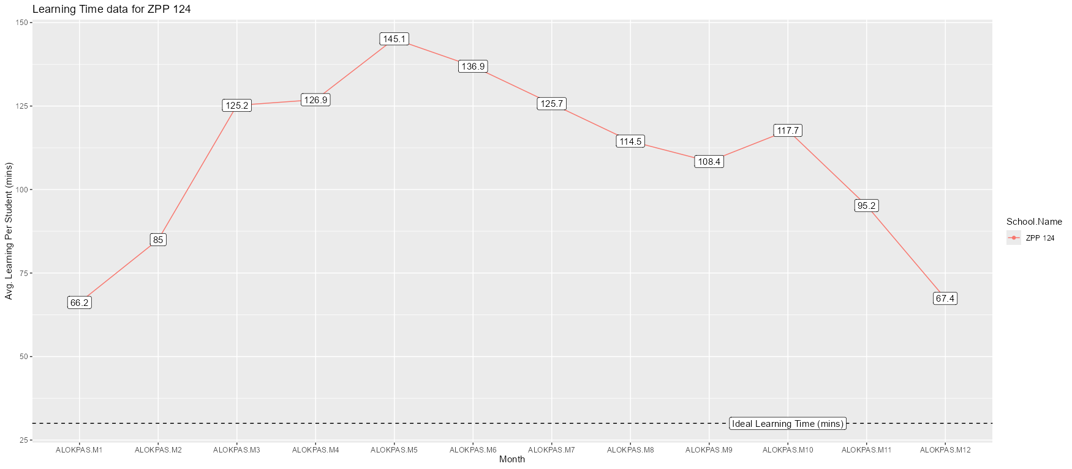
ZPP 124 is one of the schools where the learning time has been consistently above the recommended time of 30 mins.

Slide 11
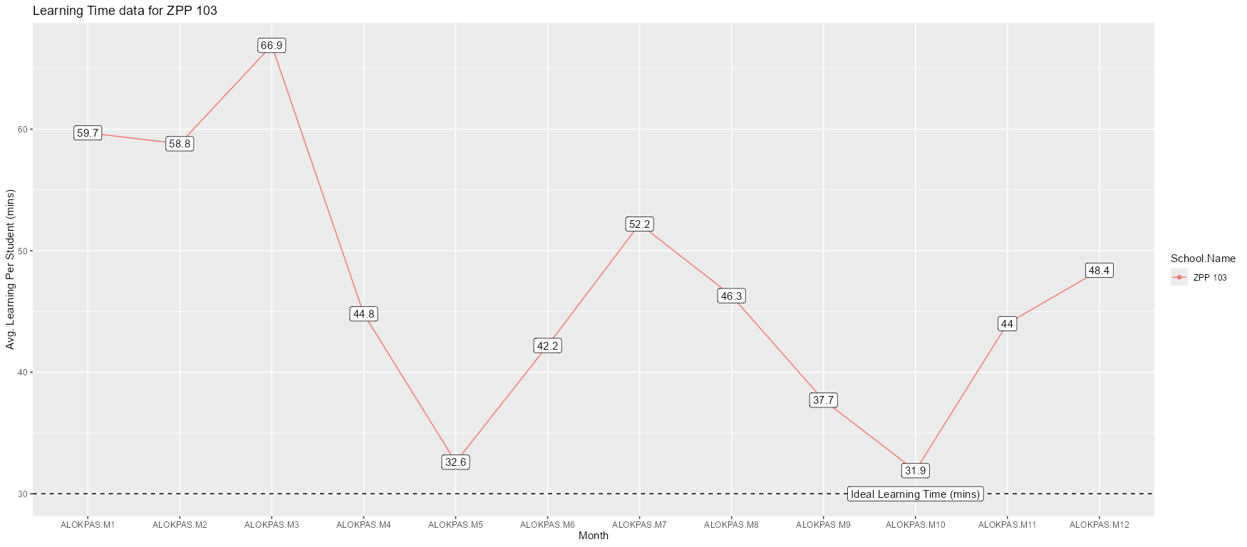
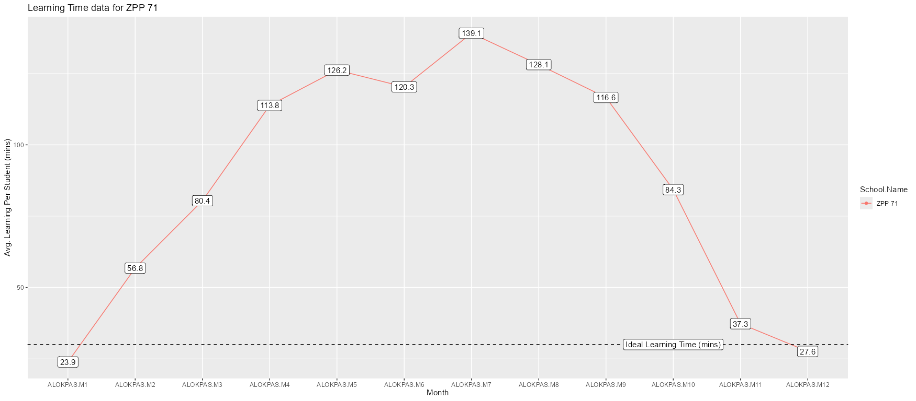
Interesting Learning time of Schools.

Slide 12
21 Schools
There were 21 schools who were able to maintain their active student count per month over the mean active student count across all schools for 9 months out of 12.
ZPP 13, 14, 17, 18, 23, 24, 30, 31, 42, 45, 51, 73, 91, 103, 121, 122, 124, 157, 133, 152, 154.
There should be a deeper analysis into how these schools are able to get the students to sign on to Khan academy and convert them into active users.

Slide 13
7 Consistent Schools
In terms of hours learned, these were the schools who consistently had students learning on Khan Academy for more than 9 months out of the year -
ZPP 42, 45, 70, 71, 91, 103, 124.
A deeper analysis should be done on why these schools are consistently able to get their students on to Khan Academy.

Slide 14
ZPP 142 is the one to emulate.

Slide 15
Conclusion
Considering the overlap between schools who were able to consistently able to keep the learning time on Khan Academy and the schools who were able to get their students to sign up and convert them into active users, ZPP 142 stands out as the main school to emulate.

Slide 16
Code repository
All analysis was done in R, code and all relevant graphs can be found on -
https://github.com/freightheave/zpp-analysis-khan-academy

Slide 17
Glossary
ASPM ➡ Active Students Per Month
ALOKPAS ➡ Average Learning on Khan Academy Per Active Student

